Slide 1

Powered by Humans and Catapulted by AI

Slide 2
Kemp Nicholas, CPA
Director of Operations
Expedited Financial Solutions, LLC
(501) 231-3115
kemp@expeditedfs.com
www.expeditedfs.com
linkedin.com/in/kemp-nicholas-cpa-42197617b

Slide 3
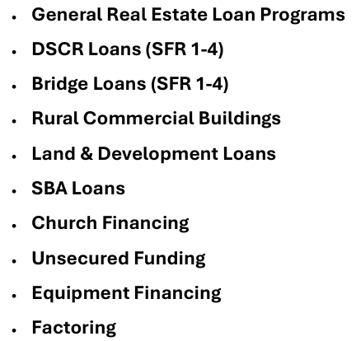
Table of Contents

Slide 4

General Real Estate Loan Programs
DSCR Loans
  Description: Debt Service Coverage Ratio loans for income-producing properties.
  Key Features: Based on property cash flow, not personal income.
  Up to 85% LTV on PURCHASES; Up to 75% LTV on CASH-OUT depending on DSCR
Bridge Loans
  Description: Short-term financing for immediate cash flow needs.
  Key Features: Quick approval, flexible repayment options.
Fix-and-Flip Funding
  Description: Financing for purchasing and renovating properties for resale.
  Key Features: Fast funding, tailored to project needs.
  Up to 95% LTV on PURCHASE and 100% rehab for very experienced investors (10+ flips past 3 years)
  1ST TIMERS – Up to 80% LTV on PURCHASE and 100% rehab
  Different programs depending on experience and FICO score
Land Loans
  Description: Financing for purchasing undeveloped land.
  Key Features: Flexible terms, competitive rates.
Development Loans
  Description: Financing for property development projects.
  Key Features: Tailored to project stages, competitive rates.
SBA Loans
  Ideal for business acquisitions in order to finance GOODWILL
  Great for expansion in order to buy real estate instead of renting
Church Financing
  Ideal for Real Estate purchases, refinance, or ground-up construction

Slide 5
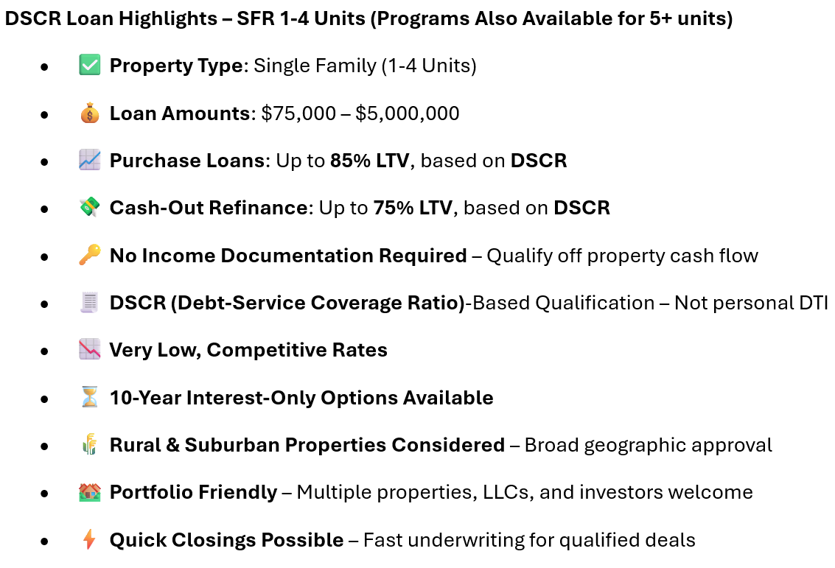
DSCR Loans (SFR 1-4)

Slide 6
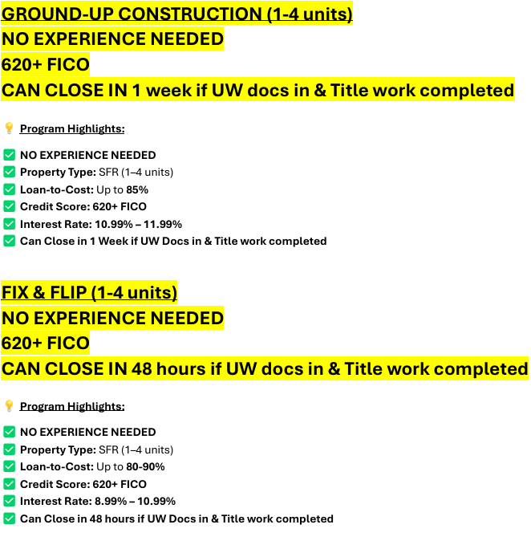
Bridge Loans (SFR 1-4)

Slide 7
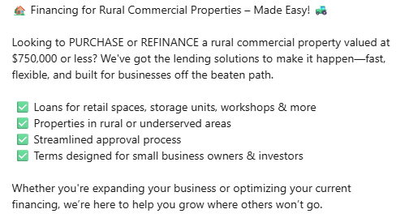
Rural Commercial Buildings

Slide 8
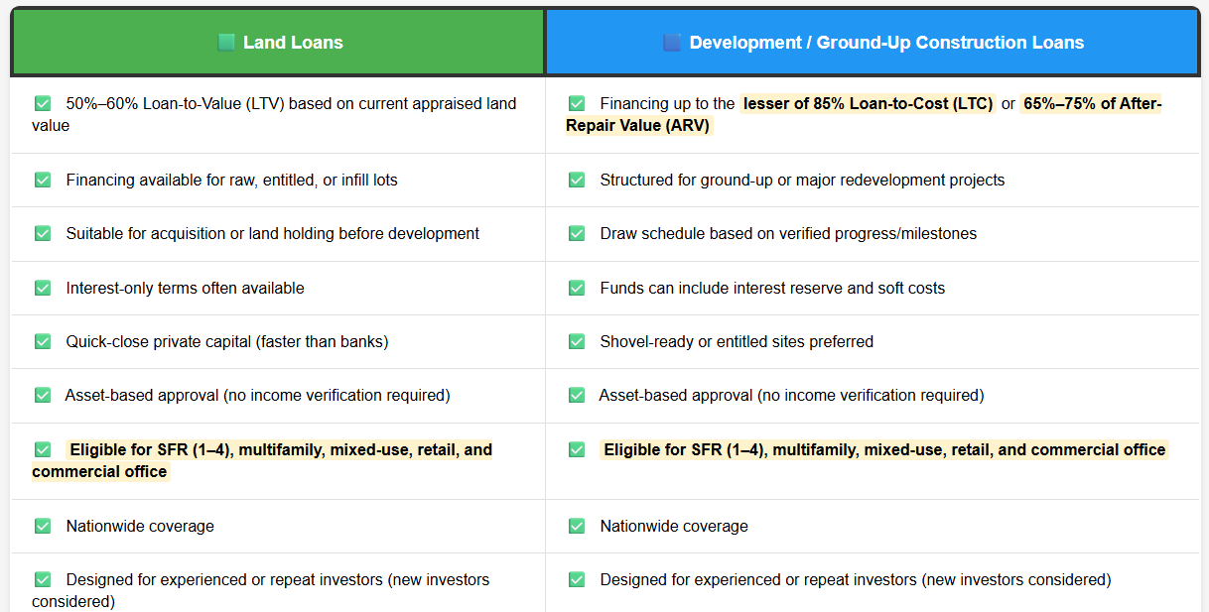
Land & Development Loans

Slide 9
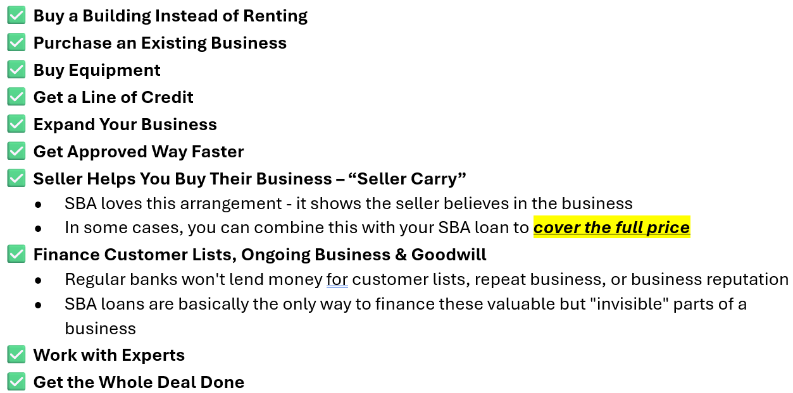
SBA Loans

Slide 10
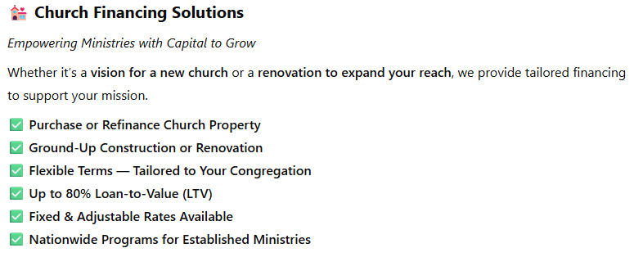
Church Financing

Slide 11
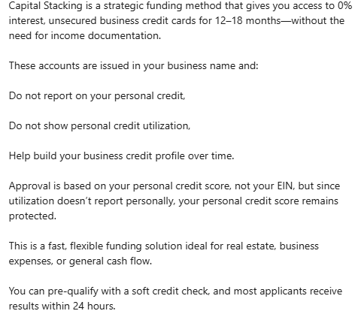
Unsecured Funding

Slide 12
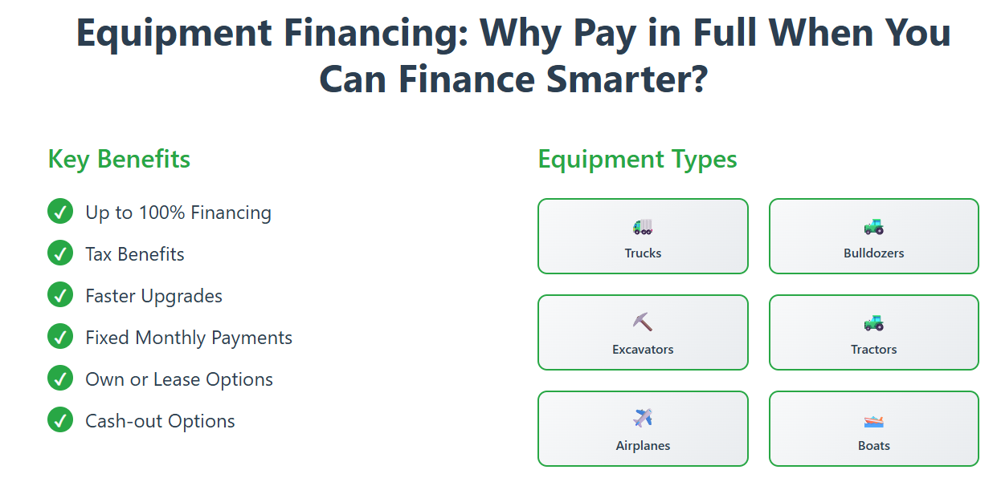
Equipment Financing

Slide 13
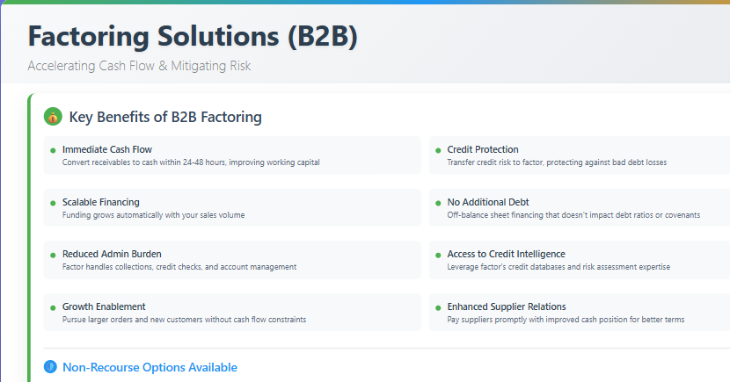
Factoring

Slide 14

Thank You
Let’s connect on LinkedIn
https://www.linkedin.com/in/kemp-nicholas-cpa-42197617b/
Your trusted partner in fast, flexible funding.

